Slide 1
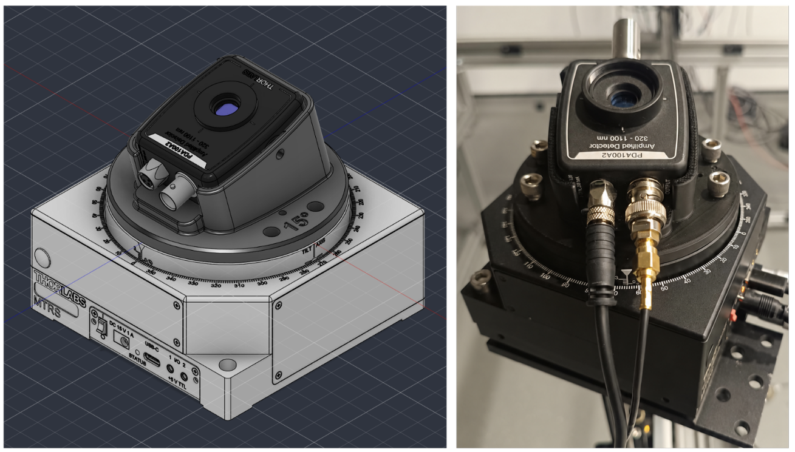
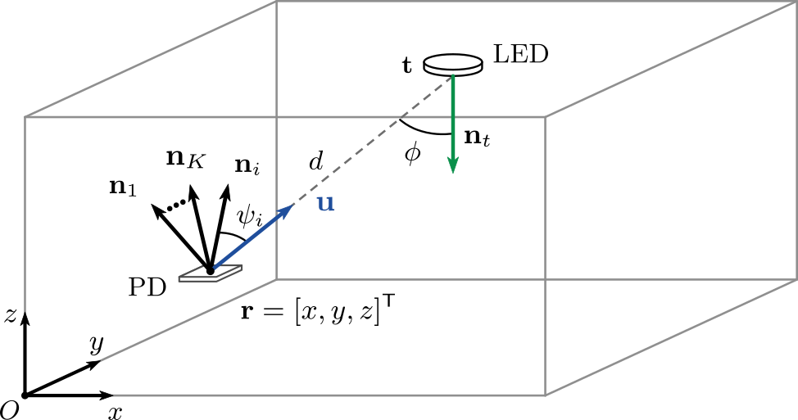
VLP

Slide 2
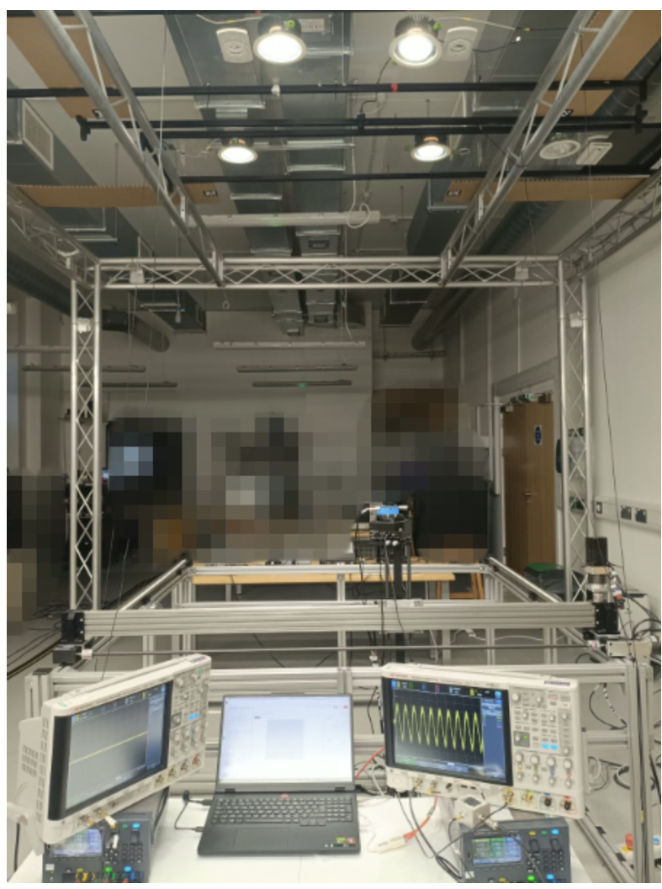
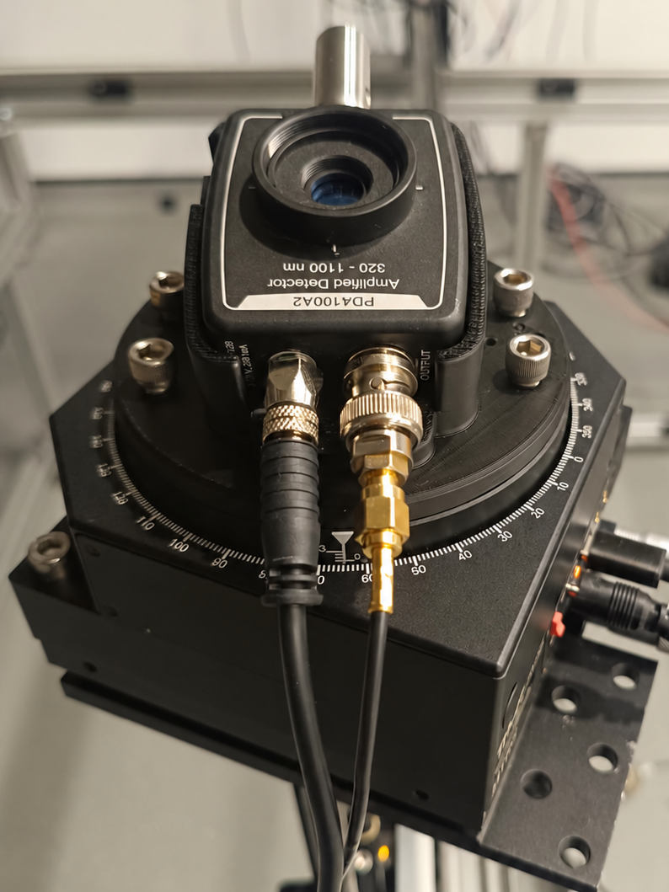
SETUP
OUTPUT(0-5V)
POWER SUPPLY
(+/- 12V DC)
OSCILLOSCOPE
(ADC)
LAPTOP
(FFT+ESTIMATION)

Slide 3
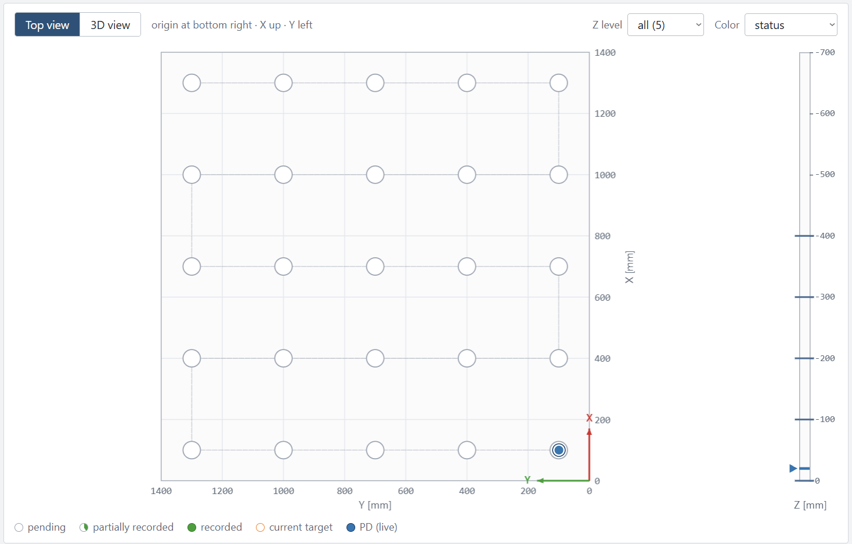
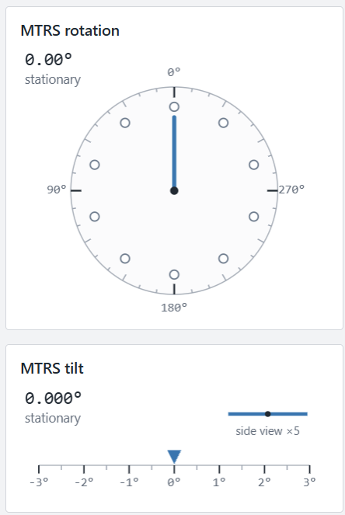

Slide 4
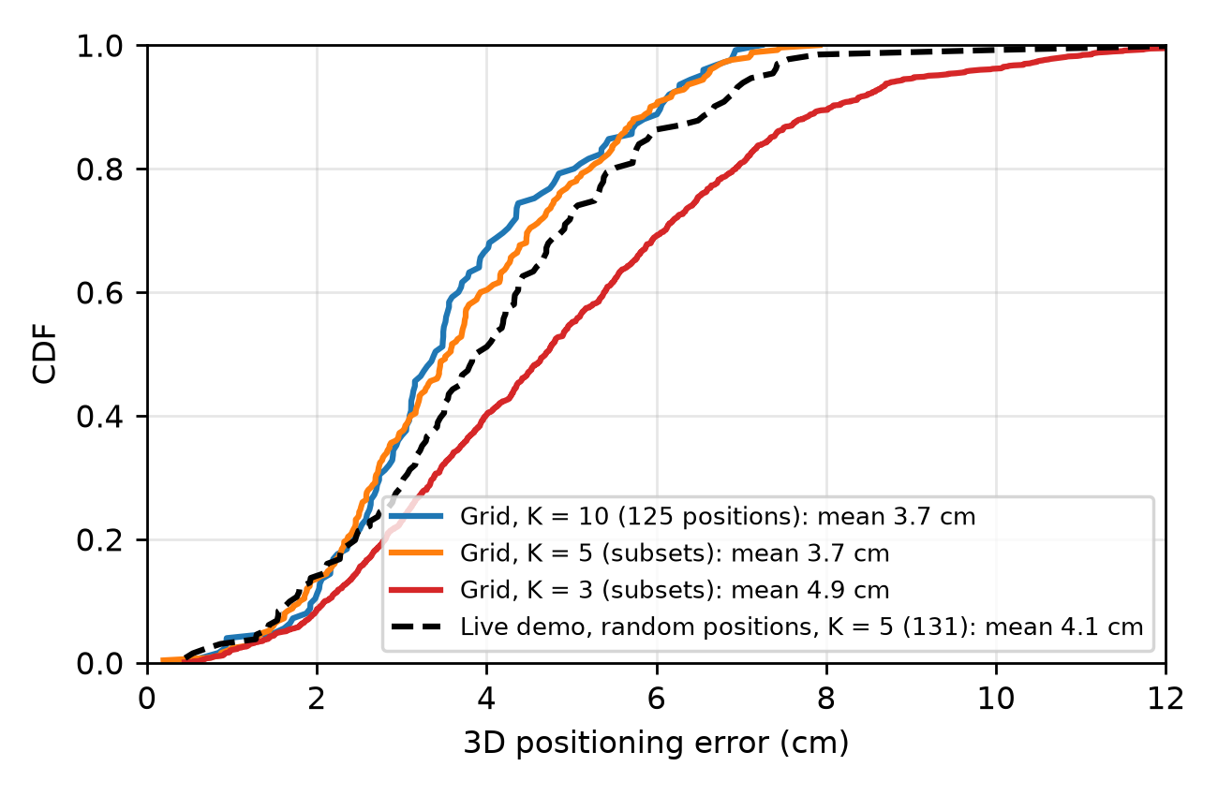

Slide 5
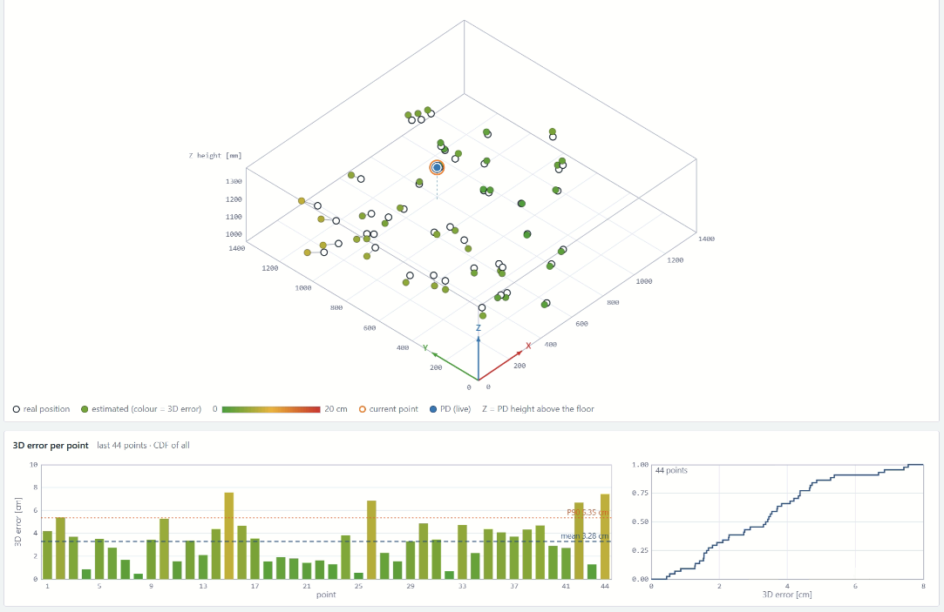

Slide 6
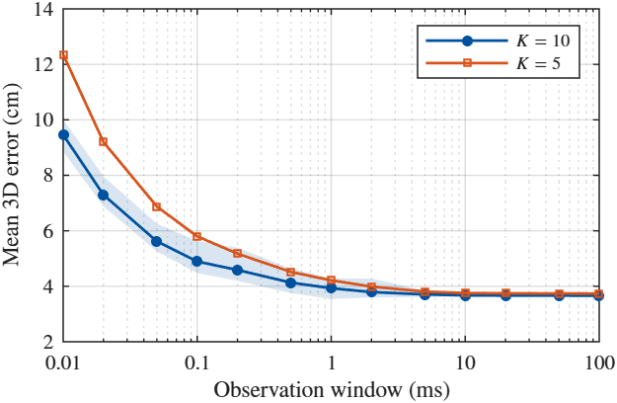
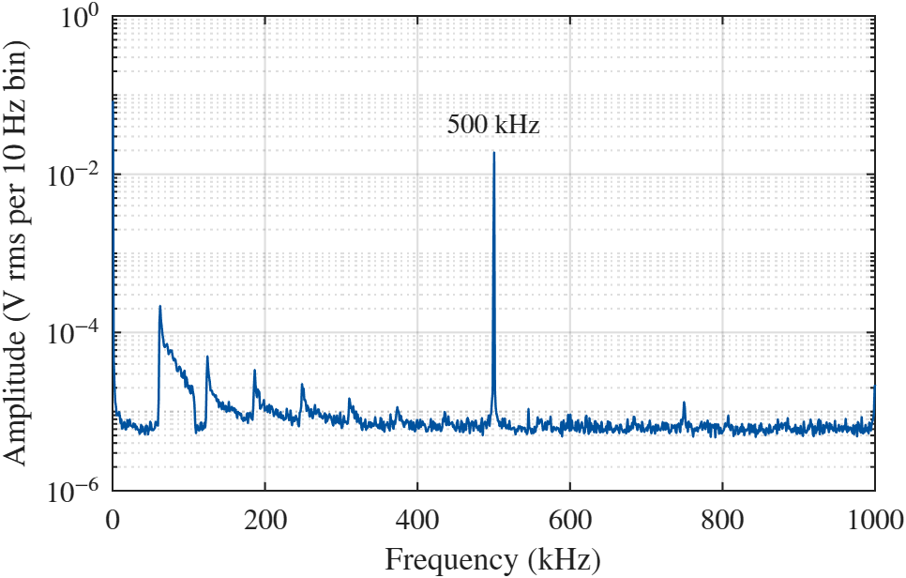
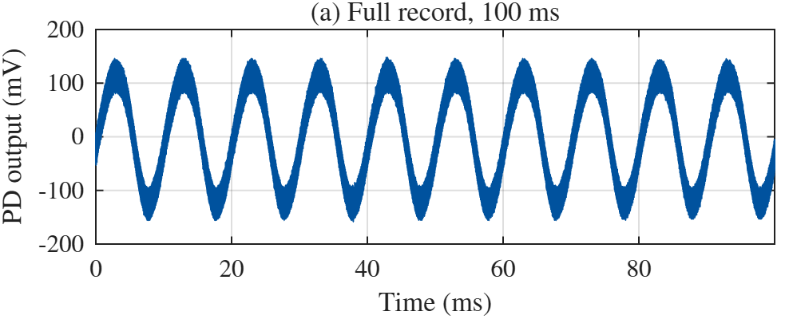
VLP
Observation window

Slide 7
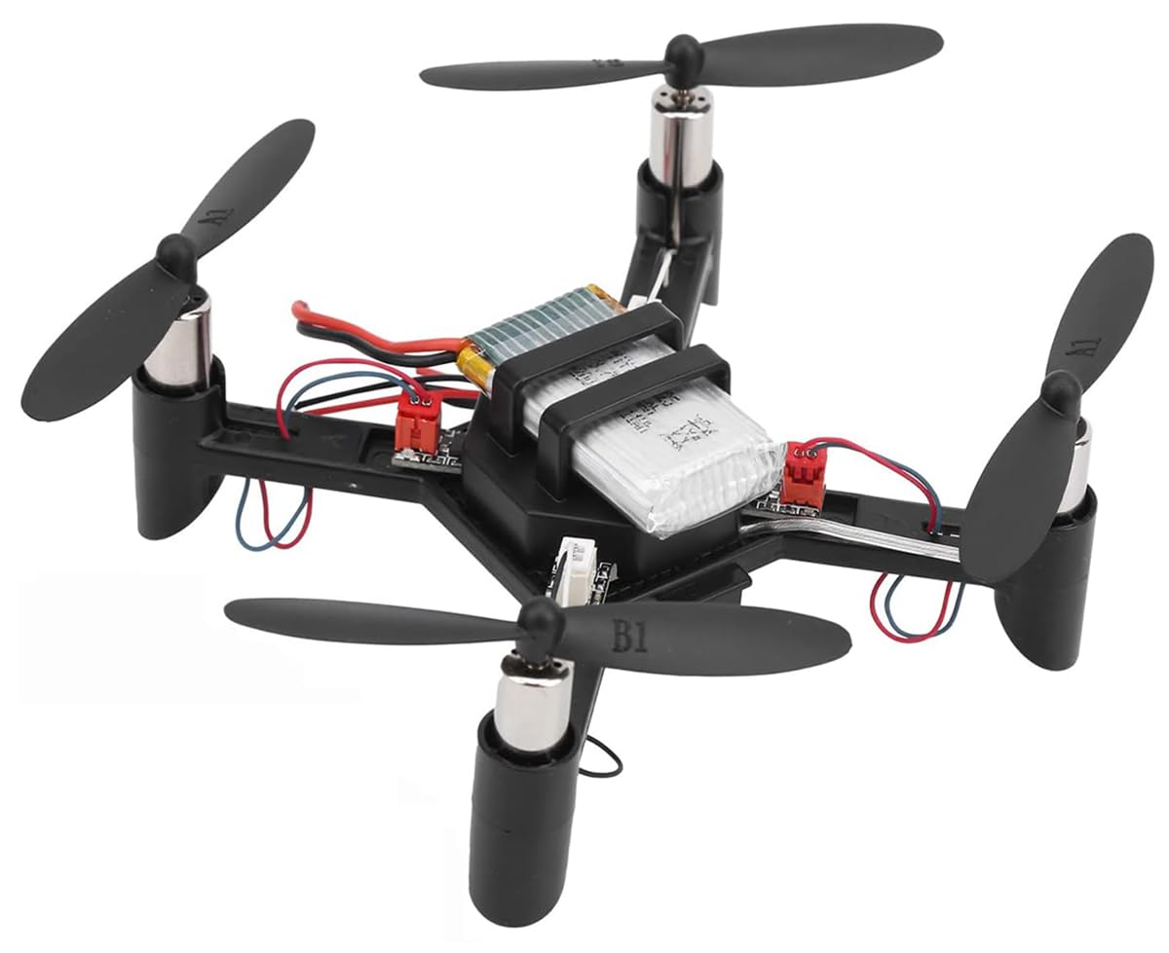
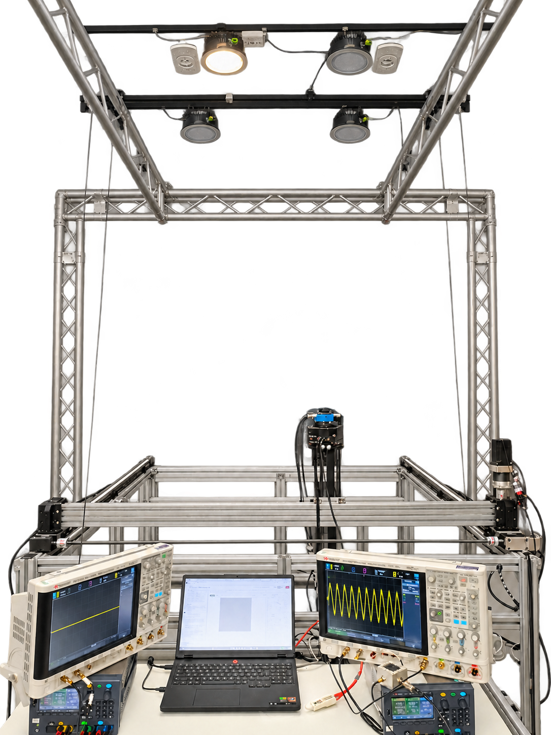
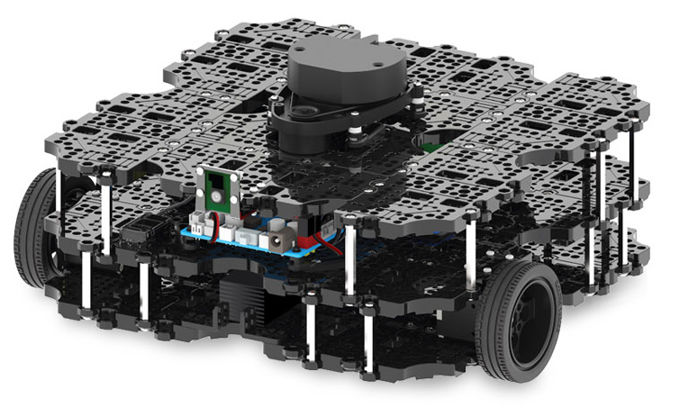
TOWARDS MOBILE RECEIVERS
Different requirements
OUTPUT(0-5V)
POWER SUPPLY
(+/- 12V DC)
OSCILLOSCOPE
(ADC)
LAPTOP
(FFT+ESTIMATION)

Slide 8
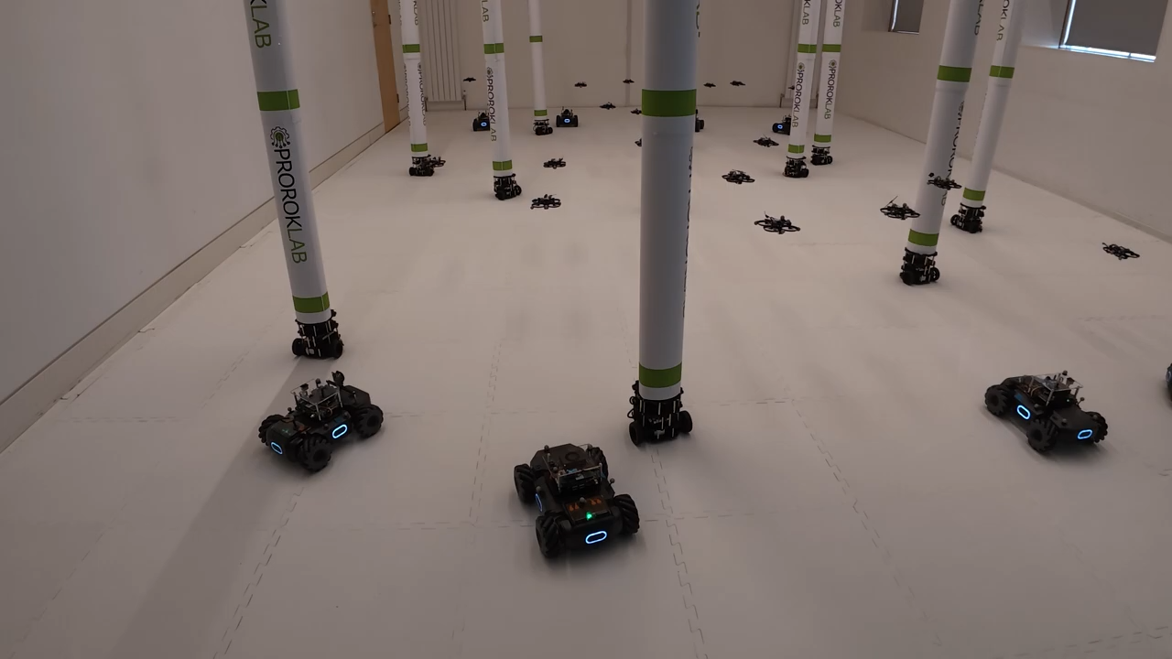
USE CASE OWP in multi-robot systems
PROROKLAB, Department of Computer Science and Technology, University of Cambridge

Slide 9
PIRAMID

Slide 10
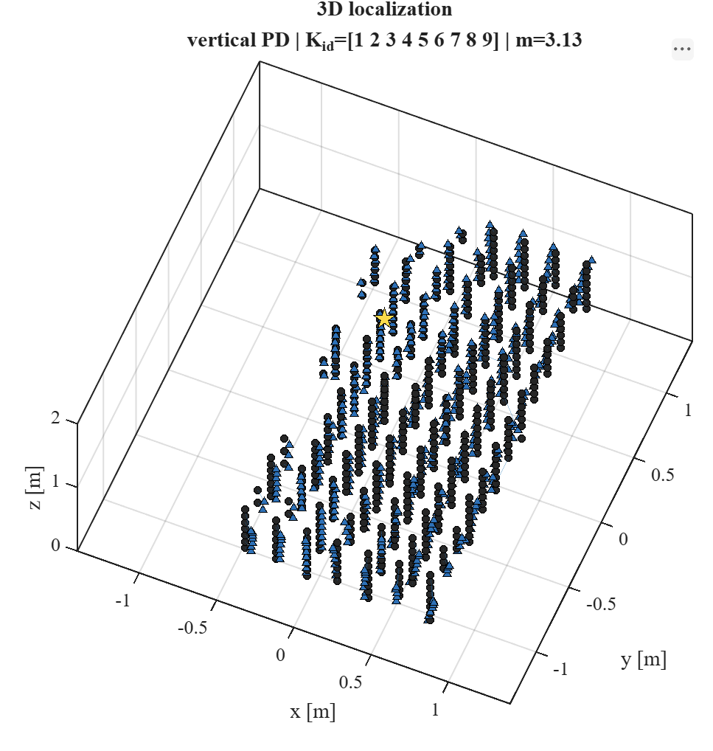
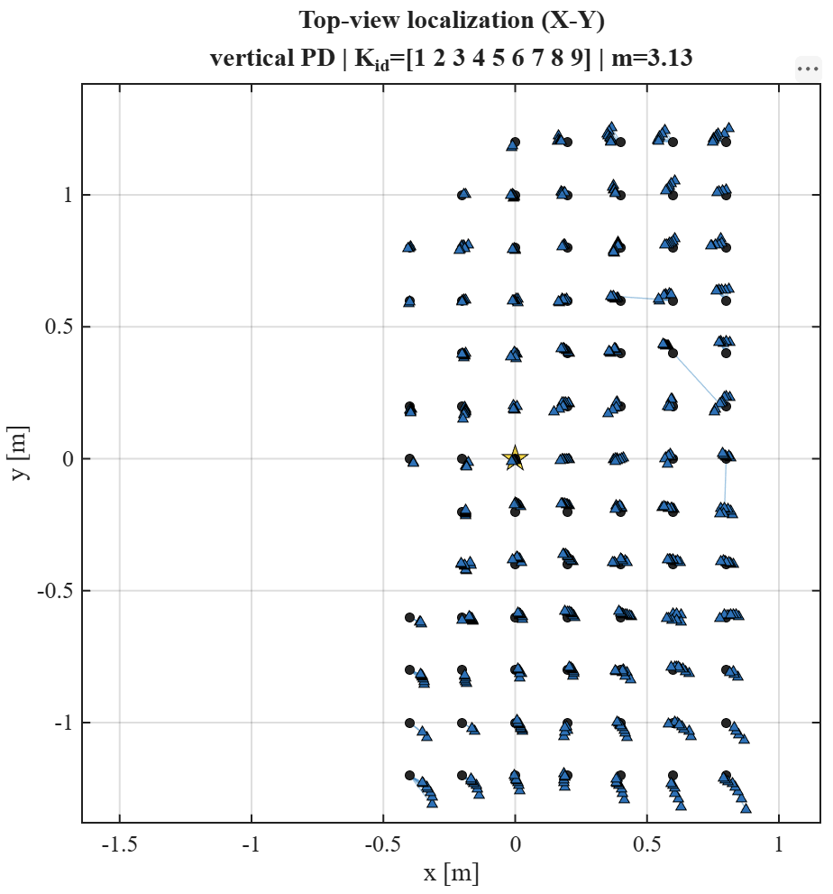

Slide 11
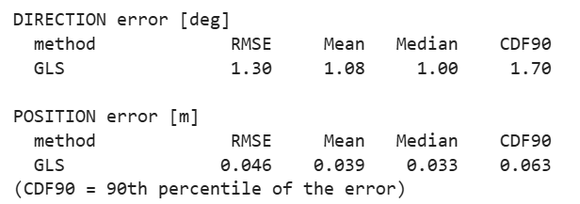

Slide 12


